Slide 1
Statistical Phylogenetics
Justin Bahl

Slide 2
Topics Covered
Statistical tests of topological robustness
Bootstrap
Bayesian Posterior Probability
Comparing Trees (Goldman et al 2000. Syst Biol)
Likelihood based test of topology (Parametric vs NonParametric)
which tree describes the data better?

Slide 3
Confidence Assessment
Bootstrap values
Bootstrapping is a statistical technique that can use random resampling of data to determine sampling error for tree topologies

Slide 4
Bootstrapping phylogenies
Characters are resampled with replacement to create many bootstrap replicate data sets
Each bootstrap replicate data set is analysed (e.g. with parsimony, distance, ML etc.)
Agreement among the resulting trees is summarized with a majority-rule consensus tree
Frequencies of occurrence of groups, bootstrap proportions, are a measure of support for those groups

Slide 5
Statistical evaluation of the obtained phylogenetic tree
• The accuracy is dependent on the considered multiple sequence alignments ;
• ML estimates branch lengths, their degree of significance and their confidence limits ;
• At present only sampling techniques allow to test the topology of a phylogenetic tree :
Bootstrapping
It consists of drawing columns from a sample of aligned sequences,
with replacement, until one gets a data set of the same size as the
original one (usually some columns are sampled several times and
others left out).

Slide 6
Bootstrapping
• Constructs a new multiple alignment at random from the real alignment, with the same size. Note that the same column can be sampled more than once, and consequently some columns are not sampled.
ATAGCCATA
ATACCCATG
ATACCCATA
ATAGCCATA
ATCCCCCAT
TCAAATGCA
TCGAATCCA
TCAAATCCA
TCAAATGCA
TCAACACCC

Slide 7
Bootstrapping
• Constructs a new multiple alignment at random from the real alignment, with the same size. Note that the same column can be sampled more than once, and consequently some columns are not sampled.
ATAGCCATA
ATACCCATG
ATACCCATA
ATAGCCATA
ATCCCCCAT
TCAAATGCA
TCGAATCCA
TCAAATCCA
TCAAATGCA
TCAACACCC
TCAAATGCA
TCAAATCCA
TCAAATCCA
TCAAATGCA
TCAACACCC
TCAAATGAA
TCGGATCAA
TCAAATCAA
TCAAATGAA
TCAACACCC
ACCAATCCA
ACCAATCCA
ACCAATCCA
ACCAATCCA
CCCACACCC

Slide 8
Bootstrapping
Ideally the bootstrap procedure will allow us to estimate a distribution of simulated trees
E
A
75%
30%
90%
C
B
D
δ
δ
Accept H_{O} critical value Reject H_{O}

Slide 9
Bootstrapping
Ideally the bootstrap procedure will allow us to estimate a distribution of simulated trees
E
A
75%
30%
90%
C
B
D
δ
δ
Non-parametric Method
Accept H_{O} critical value Reject H_{O}

Slide 10
Properties of Bootstrap procedure
• Internal branches supported by ≥ 70% of replicates are considered as statistically significant.
• The bootstrap procedure only detects if sequence length is enough to support a particular node.
• The bootstrap procedure does not help determining if the tree-building method is good. A wrong tree can have 100 % bootstrap support for all its branches!

Slide 11
Methodology
1. Consider the set of sequences to analyse ;
2. Align "properly" these sequences ;
3. Apply phylogenetic making tree methods ;
4. Evaluate statistically the obtained phylogenetic tree.
1- Multiple alignment;
2- Bootstrapping (100 samples);
3. Apply phylogenetic making tree methods ;
4- Consensus tree construction and evaluation;

Slide 12
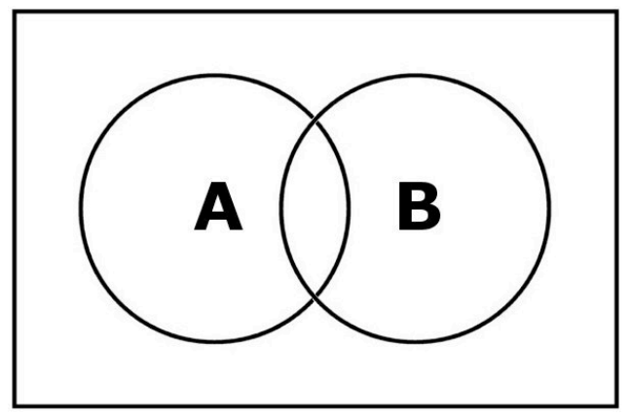
What about parametric methods?
Empirical measurement of tree space by simulation
of phylogenetic trees.

Slide 13
What about parametric methods?
Empirical measurement of tree space by simulation
of phylogenetic trees.
Let A and B represent two separate events
Pr(A,B) = Pr(B,A)
These are joint probabilities. The probability of A and B occurring is equal to the probability of B and A occurring.
This can be written as a product of a conditional probability and the probability that the condition is true. Pr(A,B) = Pr(A)Pr(B|A). Therefore, the above equation becomes:
Pr(A)Pr(B|A) = Pr(B)Pr(A|B)
This can be rearranged to the familiar Bayes Theorem
Pr(B|A) = Pr(B) Pr(A|B)
Pr(A)

Slide 14
What about parametric methods?
Empirical measurement of tree space by simulation
of phylogenetic trees.
Pr(B|A) = Pr(B) Pr(A|B)
Pr(A)
Biologists are interested in the relationship between an event and a particular hypothesis.
Let’s rewrite the above equation in a more useful form:
Pr(hypothesis|data) = Pr(hypothesis) Pr(data|hypothesis)
Pr(data)

Slide 15
What about parametric methods?
Empirical measurement of tree space by simulation
of phylogenetic trees.
Pr(B|A) = Pr(B) Pr(A|B)
Pr(A)
Biologists are interested in the relationship between an event and a particular hypothesis.
Let’s rewrite the above equation in a more useful form:
Posterior = Prior x Likelihood
Pr(data)
- Does not depend on the hypothesis so is therefore constant
- Essentially a scaling factor to ensure that the Posterior is between (0,1)
(Felsenstein, 2003, Inferring Phylogenies)

Slide 16
What about parametric methods?
Empirical measurement of tree space by simulation
of phylogenetic trees.
This can be simplified to:
Posterior = Prior x Likelihood
(Felsenstein, 2003, Inferring Phylogenies)

Slide 17
Bayesian Posterior Probability (BPP)
Exploration of the likelihood space
Per cent of simulated trees with a particular topology is the BPP
E
A
75%
30%
95%
C
B
D
BPP >95% are considered “supported”
δ
δ

Slide 18
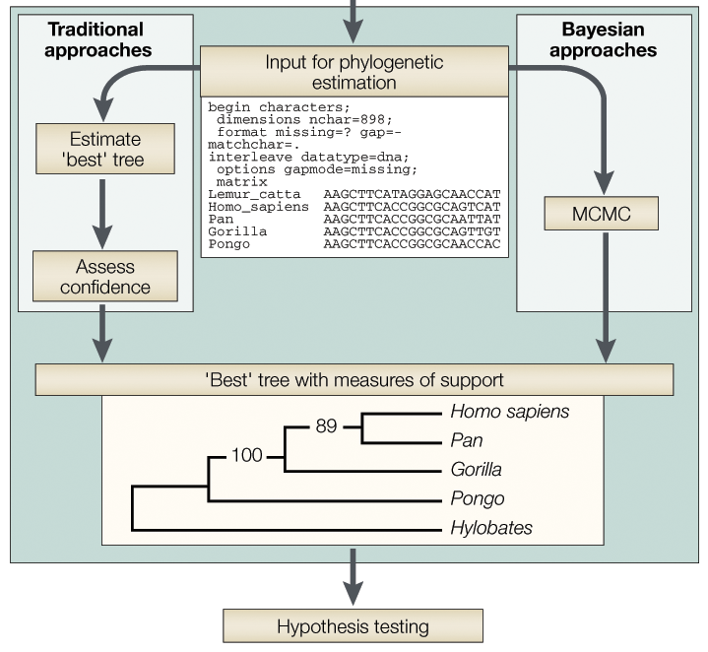
The phylogenetic inference process

Slide 19
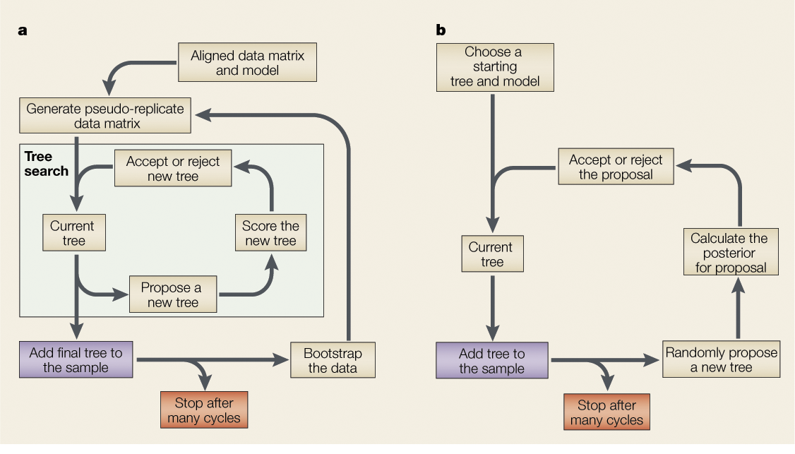
Bootstrapping
The bootstrapping approach involves the generation of pseudoreplicate data sets by re-sampling with replacemtent the sites in the original data matrix.
When optimality-criterion methods are used, a tree search is performed for each data set, and the resulting tree is added to the final collection of trees.

Slide 20
Markov chain Monte Carlo
The Markov chain Monte Carlo (MCMC) methodology is similar to the tree-searching algorithm.
From an initial tree, a new tree is proposed. The moves that change and the tree must involve a random choice.
The MCMC algorithm also specifies the rules for when to accept or reject a tree.

Slide 21
Markov chain Monte Carlo

Slide 22
Bootstrapping and MCMC generate a sample of trees

Slide 23
Summarizing a sample of trees
The MCMC yields a much larger sample of trees in the same computational time, than ML, because it produces one tree for every proposal cycle versus one tree per tree search in the traditional approach.
The sample of trees produced by MCMC is highly auto-correlated.
As a result, millions of cycles are usually required, whereas many fewer (of the order of 1,000) bootstrap replicates are sufficient for most problems.
However, the MCMC provides an empirical measurement of the topological support where bifurcation supported in the 95% distribution of trees can be said to be statistically supported.

Slide 24
Remarks
Estimation of phylogenies has become a regular step in the analysis of new gene sequences both for the study of chronic and infectious disease
Bayesian MCMC-based approaches are extending the field by answering (inference) previously intractable questions.

Slide 25
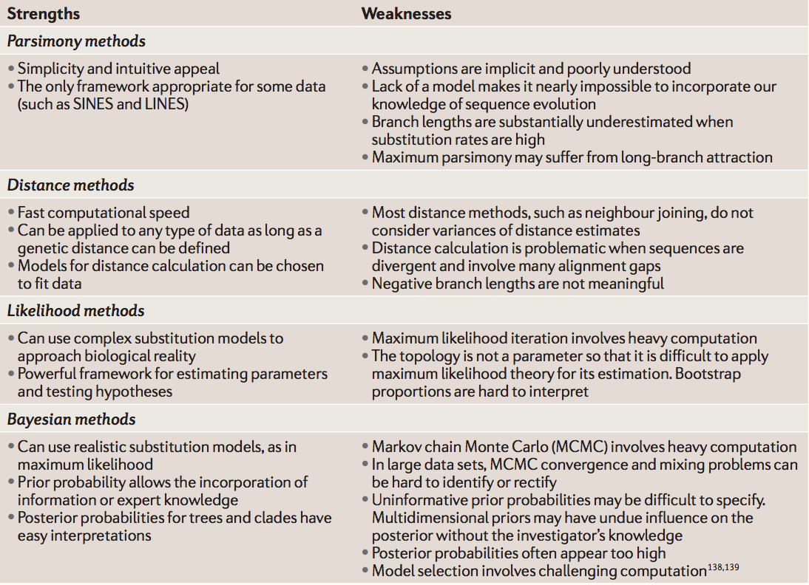
Comparison of Methods
Yang and Rannala, Nature Reviews Genetics, 2012

Slide 26
Statistical phylogenetics and hypothesis testing
Comparing Trees (Goldman et al 2000. Syst Biol)
Likelihood based test of topology (Parametric vs NonParametric)
which tree describes the data better?
Bayes Factor (Baele et al 2012 MBE, Baele et al 2013 BMC Bioinformatics)

Slide 27
